Slide 1
OIPPP
Online Internship & Placement Preparation Portal
Deekshith Gowda G · Sharath HG · Guru R Bharadwaj · E S Sukruth
Software Engineering mini-project · PES University · Release 1.0
Notes:
Introduce the team and each person's feature area: Deekshith identity and admin, Sharath listings, Guru applications, Sukruth aptitude tests and analytics. Say that the talk ends with the deviations from the submitted documents, as the brief requires.

Slide 2
Prep and placement live in two places
Finding internships
Practising for aptitude rounds
Scattered notice boards and mail threads, with no shared record of who applied or what happened next.
Unrelated third-party sites, so nobody can see whether a student is ready for the roles they apply to.
OIPPP puts both behind one login, so preparation and application history inform each other.
Notes:
Keep this short. The point is that students and the placement cell each see only half of the picture today.

Slide 3
Three roles share one portal
Student
Recruiter
Placement Admin
Profile and PDF resume
Search, bookmark, apply
Timed tests that survive a refresh
Score trends and weakest topics
Register, then wait for approval
Post, edit and close listings
Review applicants and resumes
Move each application to Offer or Rejected
Approve recruiters, disable accounts
One-offer policy switch
Question bank and tests
Statistics and CSV export
Notes:
Everyone gets in-app notifications, and status changes are also emailed. These flows are all in the demo that follows.

Slide 4
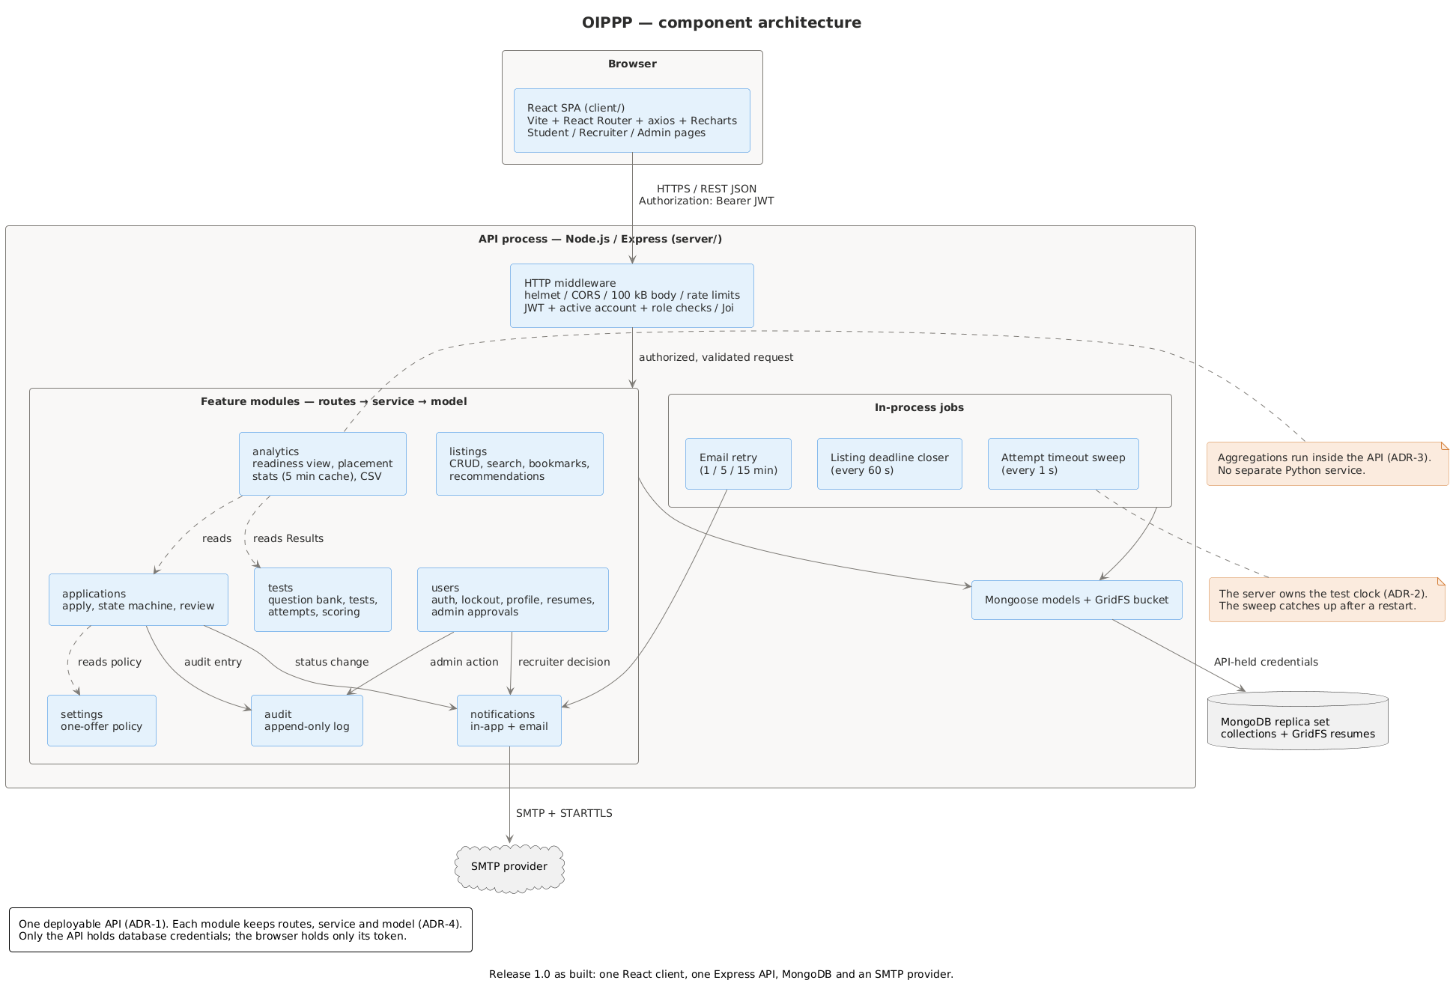
One API and one database keep the free tier simple
React client
Vite single-page app
Express modular monolith
One folder per feature
MongoDB replica set
Transactions and GridFS resumes
Three in-process jobs
Test timeout, deadlines, email retry
Notes:
The five ADRs in docs/adr give the reasons. The biggest change from the SAD is that analytics runs inside the Node API, with no Python service. That is ADR-3 and deviation rows 12 and 13.

Slide 5
Two sprints delivered all 38 backlog issues
38
162
issues, 19 in each sprint
story points in total
GitHub Projects board with both sprints
PRs into dev, CI on every PR
main synced from dev at each release
Differences logged in DEVIATIONS.md
Notes:
Open the project board if time allows. The issue count and story points come from the board. Four estimates were missing and were filled in at release: #19, #20 and #23 at 5 points, and #21 at 3.

Slide 6
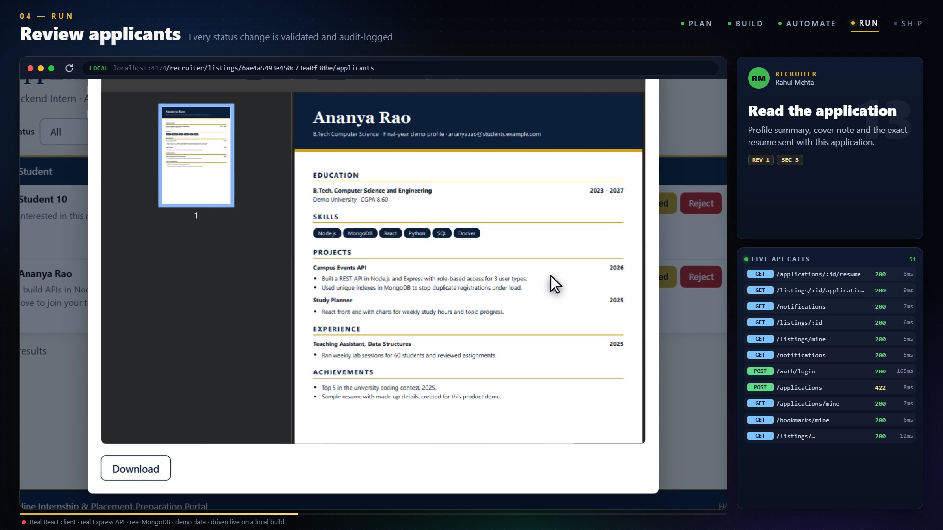
Demo: one placement, start to finish
Sign-up and admin approval
Listing, resume, apply
Review through to Offer
Timed test, refresh and reconnect
Statistics and CSV
Lockout and 360 px view
Play Sprint 2 Demo.mp4 (4:22), or run the app live.
Notes:
Say up front that the video runs on a local build with demo data and is sped up, and that some setup was done off camera through the real API: nine test questions, one listing, one applicant and two earlier test results. Personas and the resume are made up.

Slide 7
52 of 56 requirement IDs pass with evidence
539
95.16%
37 ms
automated tests passing
server statement coverage
search p95, 5,000 listings
0.29 s
0
0
slowest dashboard render
known vulnerable dependencies
High alerts, local ZAP scan
Notes:
Of the 56 IDs, 52 pass, 3 are pending and QA-2 is out of scope. These are local runs: the client, API and database shared one laptop. Full evidence is in docs/testing/test-report.md.

Slide 8
Main deviations from the submitted documents
Submitted | Built | Why
Python analytics service | Aggregations in the Node API | One service on the free tier
Late answers allowed for 30 s | Hard cutoff at the deadline | Same rule for every student
Controller layer in each module | Routes, service, model | Controllers only passed calls on
React Router 6 | Vite 8 and React Router 7 | Old versions had known advisories
2.1 MB resume returns 400 | Returns 413 | Matches the SAD and is accurate
Two-minute Sprint 2 video | 4:22 video | Shows all three roles
Notes:
The brief requires deviations to be explained at the final demo. DEVIATIONS.md has all 26 rows. Be ready to explain row 24 yourselves: some PRs were raised by someone other than the assignee, four merged with no review, and the last PRs bundled several items.

Slide 9
Frozen at v1.0.0, with these checks still open
Needs the live URL
Needs people
Out of scope
SEC-2 HTTPS and TLS grade
ZAP scan on the deployed site
Load rerun on a VM or Render
UAT with five students and a recruiter
A real phone at 360 px
Mailtrap inbox check
QA-2 availability, which needs a full placement season
Notes:
State this plainly. The product works and is tested locally, but it has not been deployed. The steps for each check are in section 6 of the test report. UAT is planned for 19 to 21 November 2026.

Slide 10
Questions?
github.com/Online-Internship-Placement-Prep-Portal/OIPPP
Notes:
The README links the video, docs, test report and deviations log.

